Slide 1
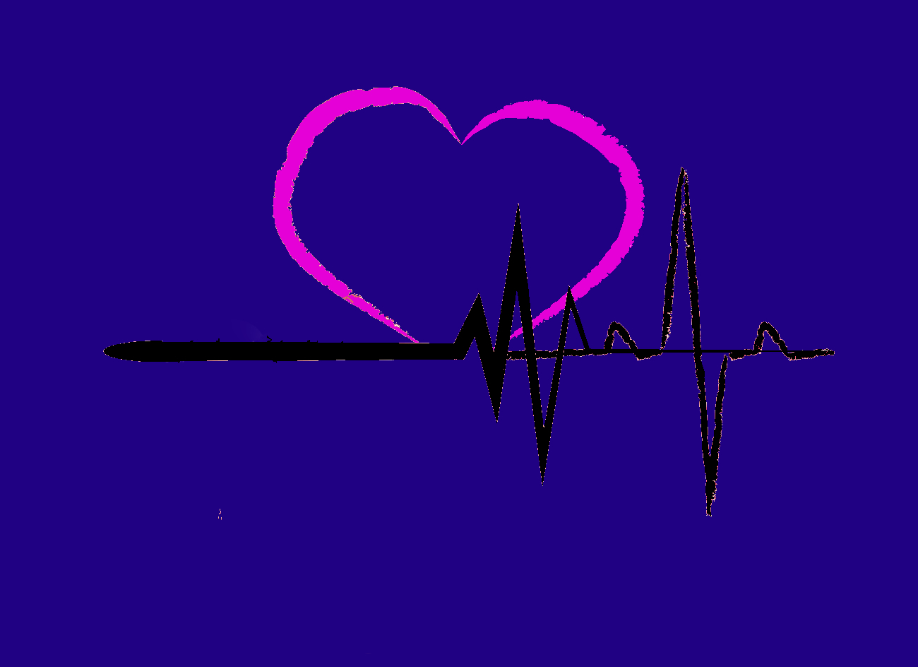
Rescue Band
Kavya Sundaresan, Venorth Logan, Yosihan Yogeswaran, Reshad Mohsini

Slide 2
Panic Disorder
Intense feelings of terror (panic attacks)
Symptoms: rapid heart rate, hyperventilation, feeling a sense of danger, numbness in hands, chills

Slide 3
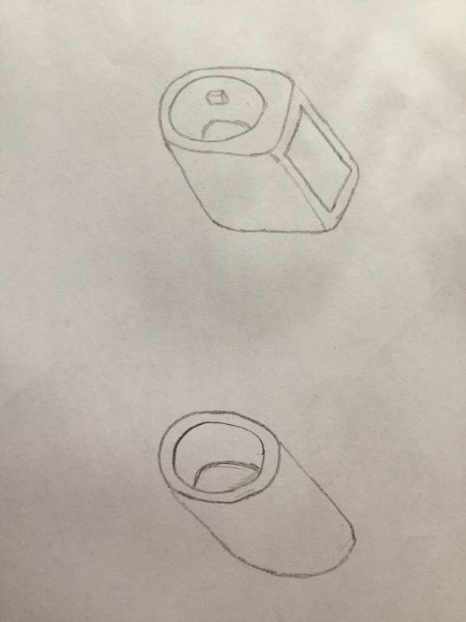
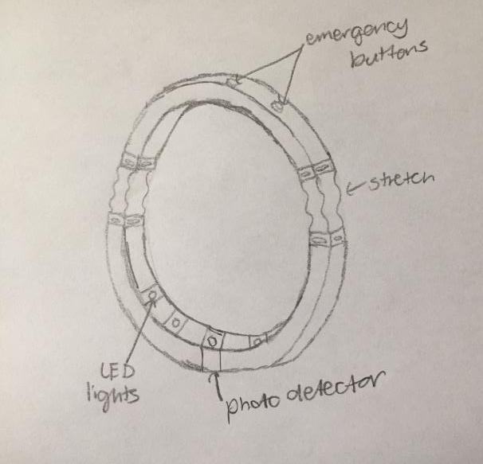
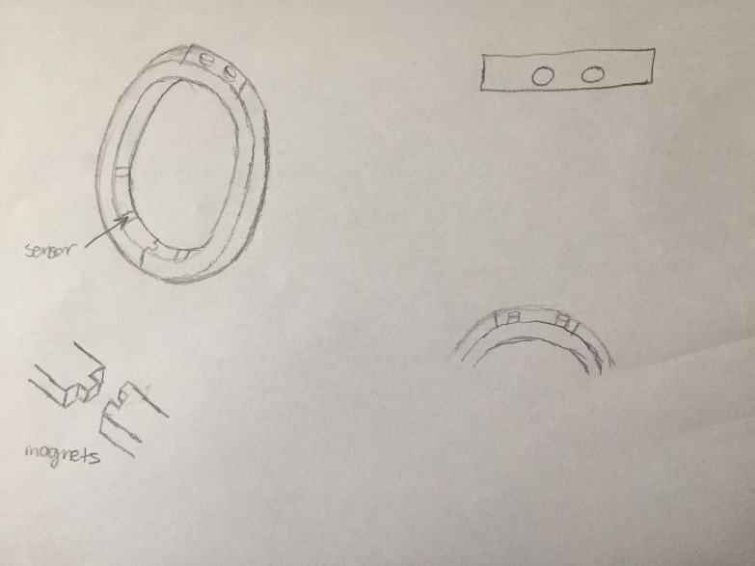
Iteration Process

Slide 4
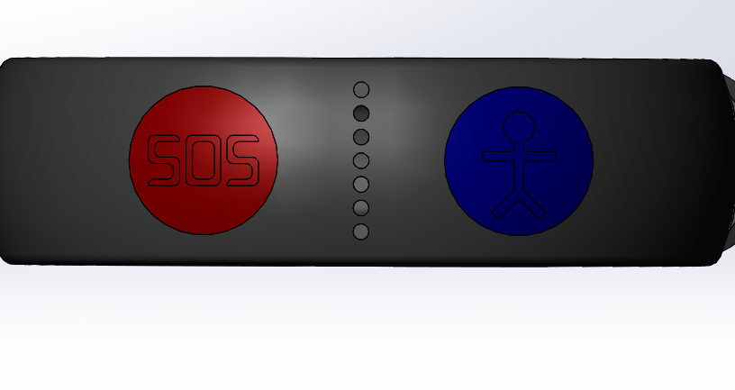
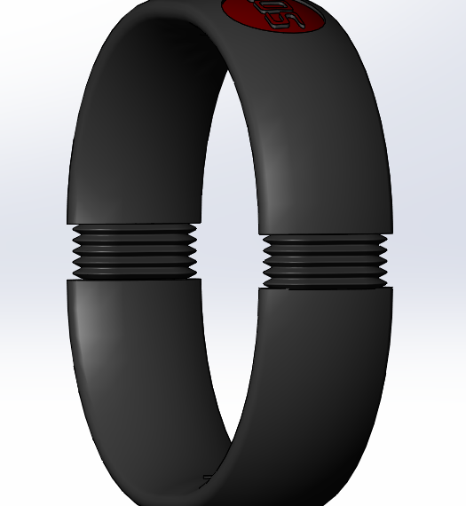
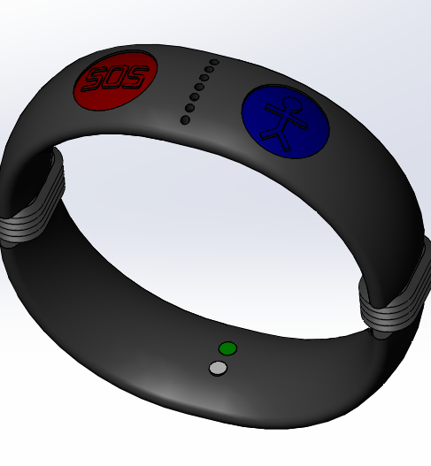
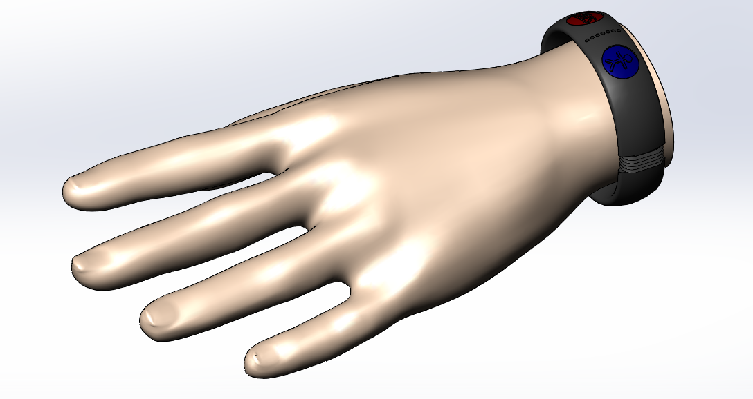
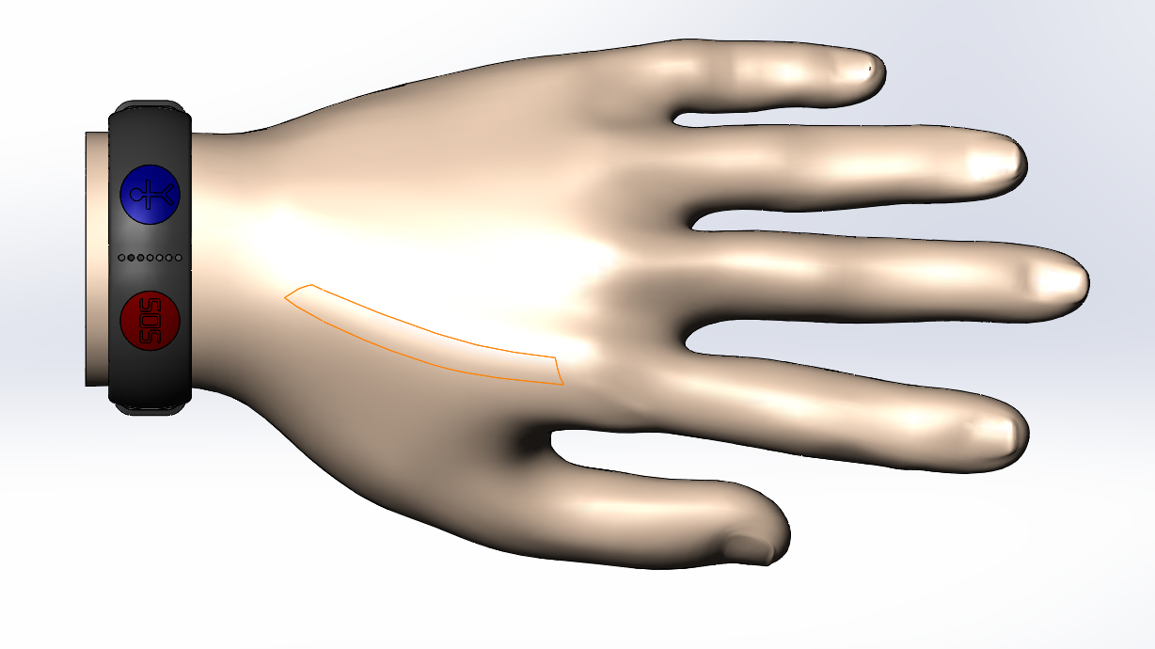
Rescue Band
Notes:
-this is the rescue band
-it is a band that takes the heart beat and pulse from user using the sensor
-the band includes 2 buttons on the top for sos and a guardian as well as a mic to allow the user to respond
-there is also a rubber stretch material that sits in-between the top and bottom in order for the band to sit comfortably on the wrist

Slide 5
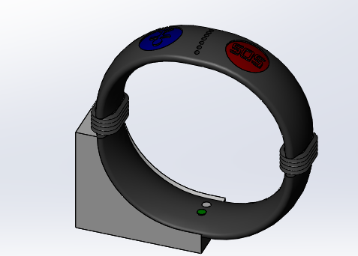
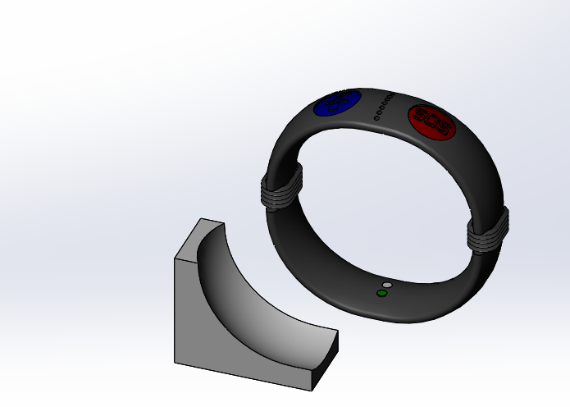
Induction Charging

Slide 6
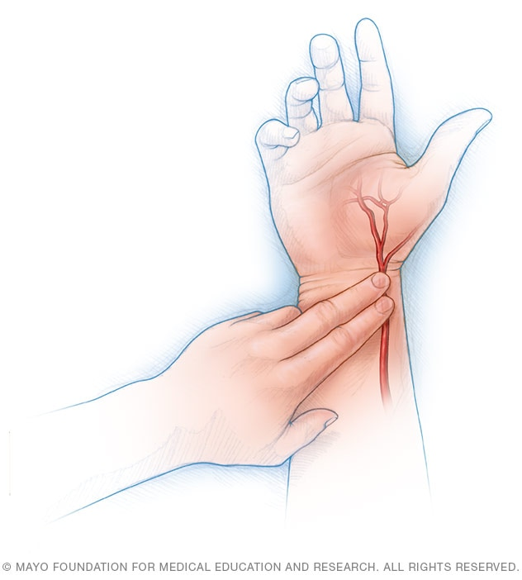
Photoplethysmography
Emit low-intensity infrared light
A photodetector will detect the light intensity in the blood
The reflected light is proportional to the volume of blood
Frequency demodulation will be used to calculate respiratory frequency

Slide 7
Bill of Materials
Item # | Name | Product | Quantity | Cost | Company
1 | OEM waterproof speaker | Speaker | 1 | $0.54 | Alibaba
2 | CMA-6542 PF | MIC | 1 | $0.62 | Digikey
3 | XD-58C pulse sensor | Heart Rate Sensor | 1 | $0.94 | Alibaba
4 | 12 mm short touch metal push button | Push Switch | 2 | $0.60 | Alibaba
5 | Micro Size Bluetooth 4.0 | Bluetooth | 1 | $3.90 | Alibaba

Slide 8
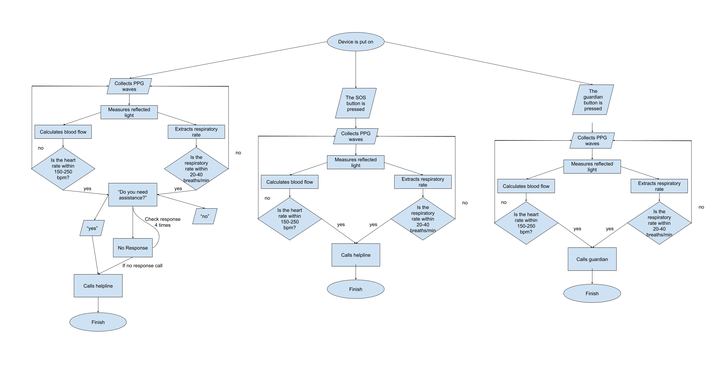
Algorithm

Slide 12
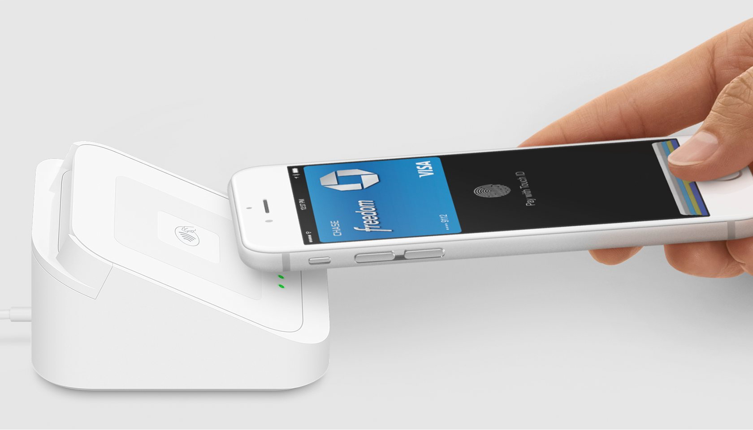
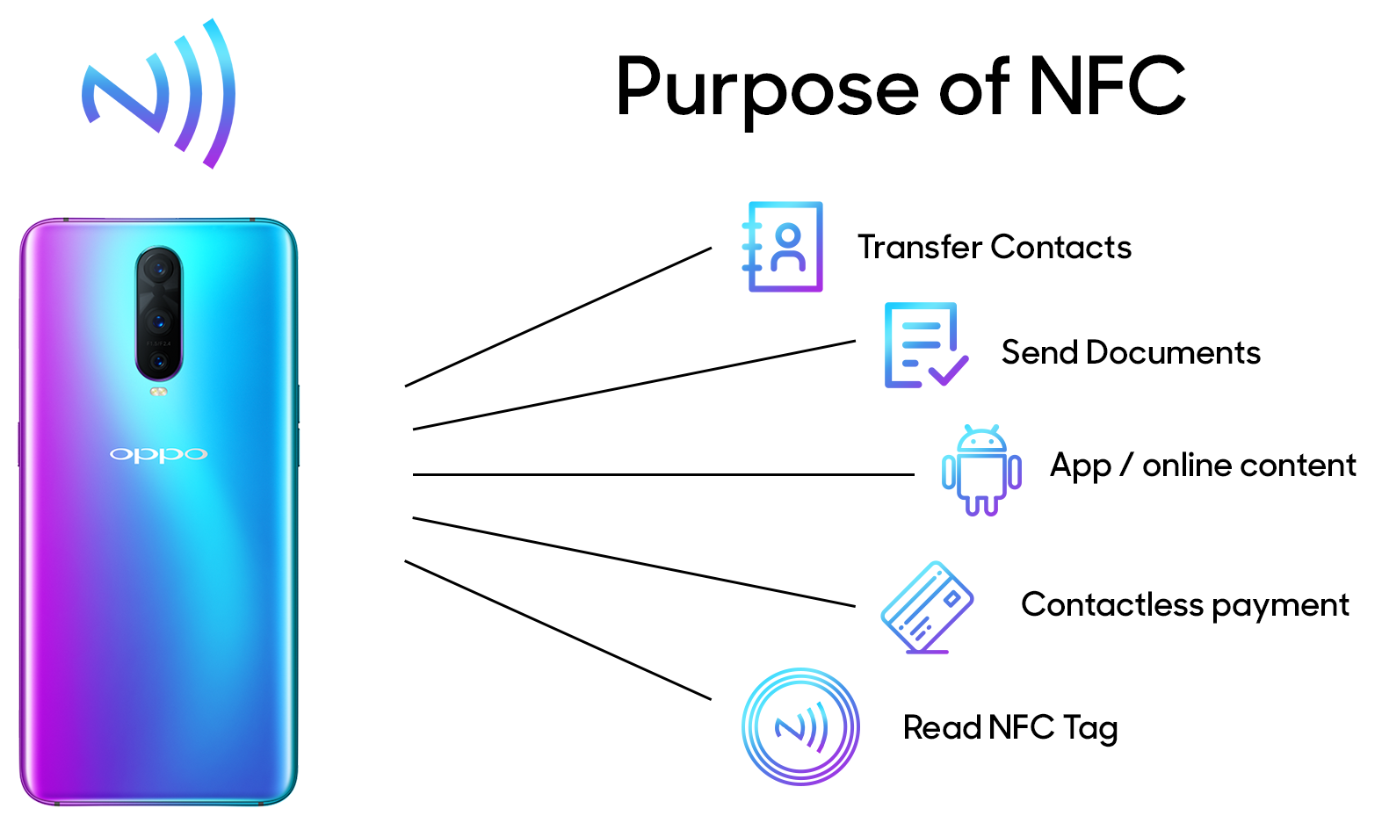
Rescue Band NFC technology
NFC or Near-field communication devices can act as an electronic identity document. They are currently being used in contactless payment systems, like contactless payments using phones or apple watches. NFC can also be used for sharing small files such as documents and even directing the receiving device to a location with fast connections to share larger media such as photos, videos, and other files.

Slide 13
User interface
Journal

Slide 14
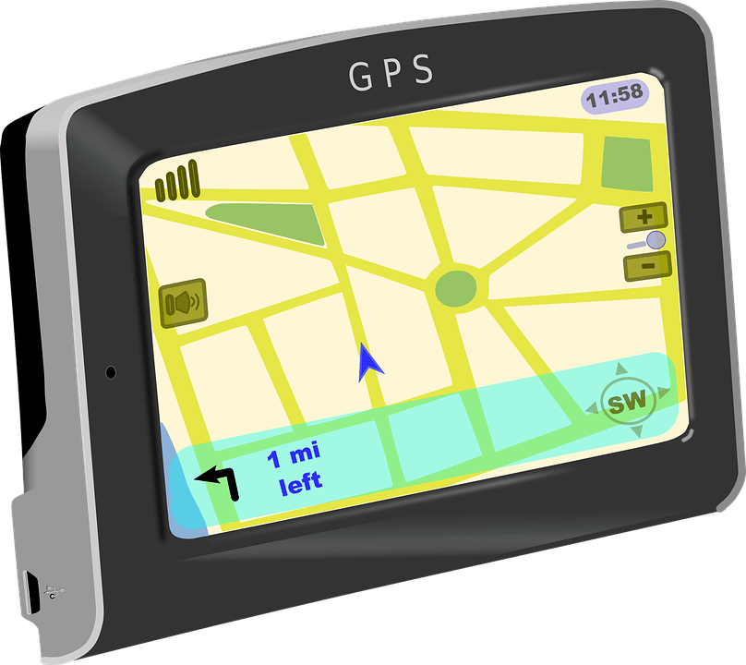
Next Steps
Sensors to check for numbness and activate algorithm
Implement a bar code for the medical database
Work for different diseases
Add a GPS

Slide 15
Thank You!

